Slide 1
Twitter Sentiment Analysis
Benjamin Bai, Alvaro Mendizabal, Charles Pan
Notes:
Anyounghaseo, this is the Twitter Sentiment Analysis

Slide 2

Deliverables
Consumer Opinion Feedback through Sentiment Analysis
Model to predict sentiment on inputted text, company or products
Breakdown on Keywords for company strategy decisions
Notes:
We provide a Sentiment Analysis on Tweets, in which our model can predict on a 90% accuracy of whether a tweet is positive/negative/neutral.
We provide infographics on the sentiment ratio between the positive or negative based on your word parameter.
We also have further infographics of the specific words tied to your parameter.

Slide 3
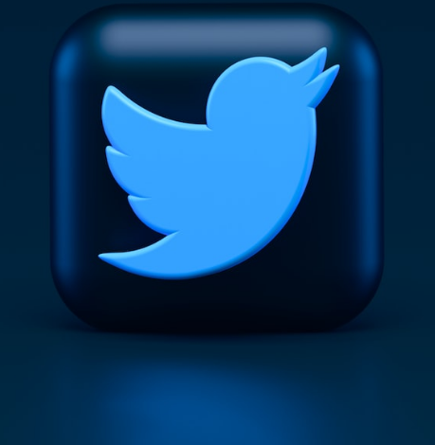
The Influence of Twitter
9th most visited website globally
25% of US Adults use Twitter
Generally more unfiltered opinions
Notes:
9th most visited website globally, 7th favorite social media platform
25% of US adults use Twitter, expected to grow to 329 million users in 2022
42% Twitters users have a college education, 85% earn more than 30k, and 34% earn more than 75k
33 Twitter Statistics That Matter to Marketers in 2022 (hootsuite.com)

Slide 4
Our Model
90%
Notes:
Our model has a 90% accuracy of classifying whether a sentiment is negative, neutral, or positive.
The only input our model requires is data from Twitter of all the Tweets and nothing else, the tweets goes through a filtering and cleaning process where all the words are broken down and put into a standard formatting such as lowercasing, lemmatizing, removing of punctuations/etc., and pandas.
From there, we are able to find out the counts of each word throughout every tweet and because the model has already predicted if something is positive or negative; we can tokenize and count all the words associated with negative/positive and output the top words of each.

Slide 5
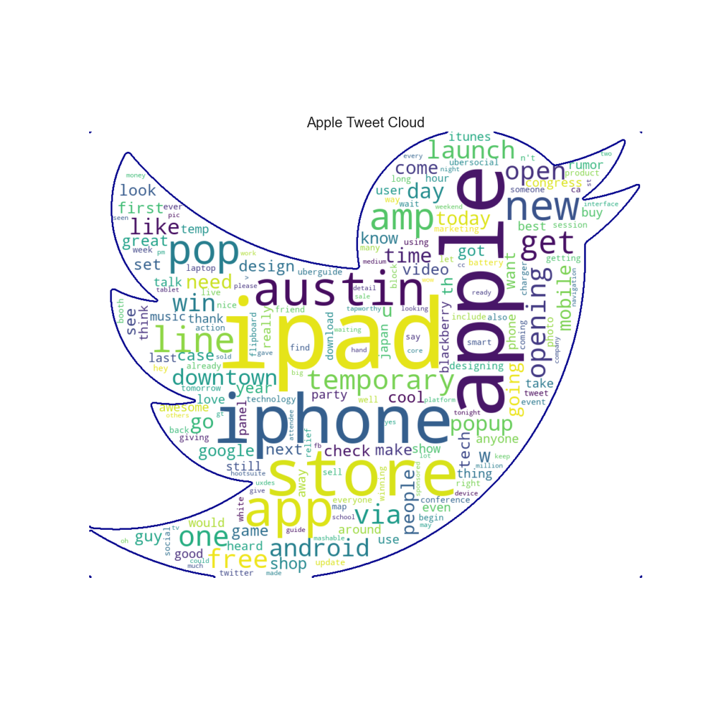
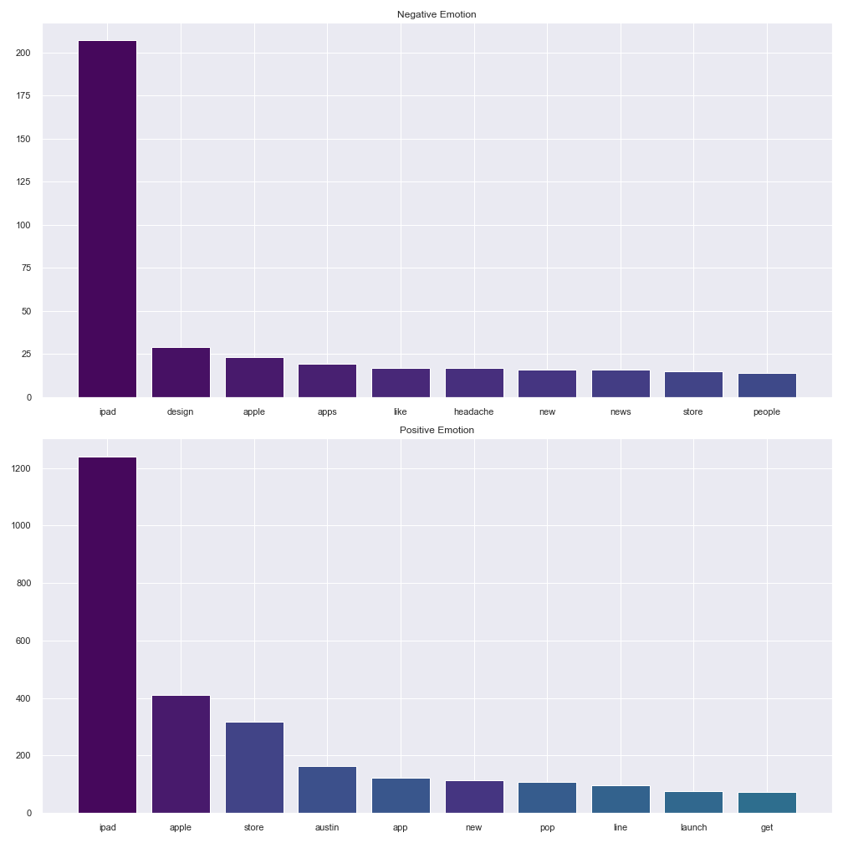
Notes:
The following are two specific infographics pertaining to Apple; it shows the word counts for positive and negative sentiments. This could be useful for finding huge outliers
Especially in regards to Negative sentiment. For example, headache in negative could mean there is an issue with the screen display or lighting from Apple products, design is another one.

Slide 6
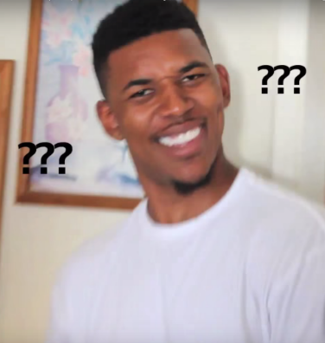
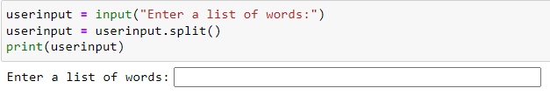
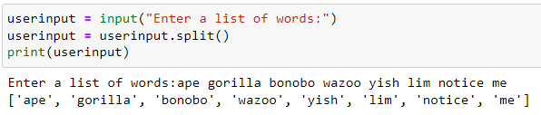
Is This Only For Apple?
Notes:
While we keep droning about Apple, our model/product can do much more.
We have an user input that allows the user to look up a list of words or maybe even one word, and it’ll create infographics based off the word or list of words. So, if you were focused on your new product line the iGlass; you just need raw data from Twitter and punch in the word iGlass into the list of words.
From there, it’ll output infographics from those Tweets that only contain the word.

Slide 7
Conclusion
Why do you need this?
Analyze Tweets (Products or Company) to check the public sentiment
Track Sentiment over time for downward/upward trend
Check for words associated to Positive of Negative sentiment to see if any are easily resolvable
Notes:
Well, why do you need this? Public sentiment on companies is very strong as no one wants to buy from a company with very poor reputation. It’s very crucial for a company to keep their brand name clean, and our model/product can help by finding the issue before it becomes too large of an issue. Track public sentiment over time, and look for words that get mentioned repeatedly; then either bolster the positives or try solving the negatives.

Slide 8
Any Questions?
Alvaro
Ben
E-Mail
LinkedIn
GitHub
Charles Pan
charlesmpan@gmail.com
www.linkedin.com/in/charles-pan-/
www.github.com/charlesmpan

